Slide 1

DRIV STUDIOS PLAYLIST DUEL
Ria Rajan, Vidyut Baskar, Deep Sanyal, Ilya Vaschillo
Mentor: Zach Barth

Slide 2
Original Feature List
3 Separate Functions
Scaling
User Inputted Playlists
Duel Multiple Playlists
Customizable Statistics
Graphical data Representation
Music Recommendation
Genre Recommendation
Determine “best playlist”
Button Sound Effects
Realtime Playlist Data
Display Playlist Covers

Slide 3
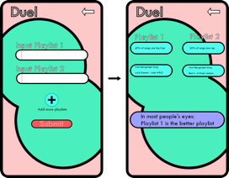
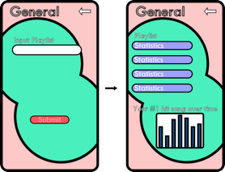
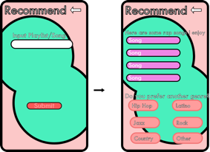
Original Wireframes

Slide 4
Sprint 1
01
02
03
Sprint Goals
Sprint Results
Sprint Takeaways
UML Diagram, finalized wireframes, utility functions
Got familiarized with Spotify API and created our final wireframes
Meeting outside of class and asking for help when needed

Slide 5
Sprint 2
01
02
03
Sprint Goals
Sprint Results
Sprint Takeaways
Completing our MVP. Return stats from Spotify and create our screens in flutter
Finished our MVP! Functioning user interface, input playlists, retrieve data
Prioritize out of class communication and focus on specificity

Slide 6
Sprint 3
01
02
03
Sprint Goals
Sprint Results
Sprint Takeaways
Polish our final product. Return genre insights and finish all screens
Transfer data between screens and added popularity and mainstream meter
Communicate before merging and work in our own branches

Slide 7
Sprint 4
01
02
03
Sprint Goals
Sprint Results
Sprint Takeaways
Focus on quality assurance and user feedback
Finished duel and general statistics screen, deliverables, and presentation
Our finished app should be polished and meet the original requirements

Slide 8
Actual Features
Cut Features
Added Features
Duel Multiple Playlists -> Duel 2 Playlists
Modified Features
Graphical Representation
Music Recommendations
Genre Recommendations
Customizable Statistics
Analyze differences in playlists
Display Playlist Covers
3 Separate Functions -> 2 Separate Functions

Slide 9
Final Features
2 Separate Functions
Scaling
User Inputted Playlists
Duel 2 Playlists
Analyze Differences in Playlist
Determine “Best Playlist”
Button Sound Effects
Realtime Playlist Data

Slide 10
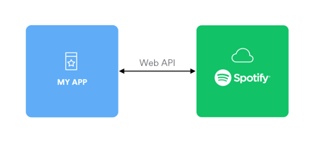
Technical Product
Spotify SDK in Flutter interacts with Spotify API
Client ID and Client Secret ID used to authenticate using REST principles
Utility functions asynchronously GET playlist and track data
Results are derived from this data

Slide 11
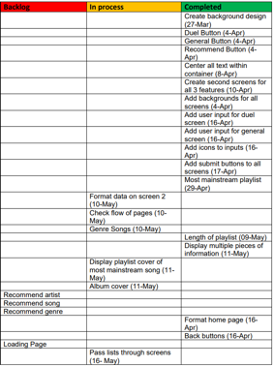
Quality of Product
New Product owners
Tested Product on Friends/Family
Ensured progress
Track of backlog
UI
Features

Slide 12
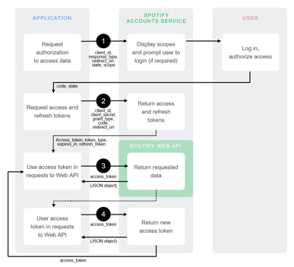
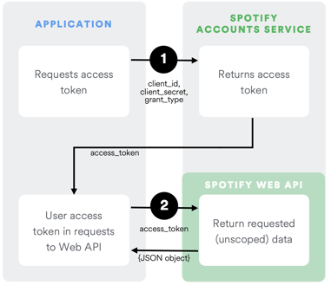

Biggest Challenge (Deep)

Slide 13
Agile Development Takeaway
Long term goals
Short term goals
Meetings and Retrospectives
Create long term goals during the beginning sprint meeting.
Use short term mini-tasks to stay on track on a daily basis.
Create long term goals during sprint meetings and short term goals during retrospectives.

Slide 14
Demo

Slide 15



Future Plans
Recommend
Add Songs
Duel Multiple Playlists
Recommend songs based on song, playlist, or genre
Ability to add recommended songs to personal Spotify playlist
Duel more than 2 playlists against each other

Slide 16
Why Us
Dueling Feature
Established groundwork
Promising Future
Unique, and heavily developed around customer experience
We gather all the playlist statistics we need to further develop our features.
We still have room to improve our dueling feature.

Slide 17
THANK YOU

